Slide 1
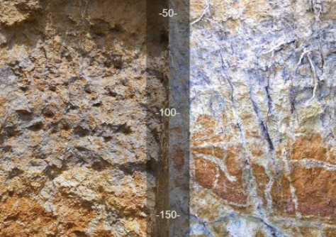
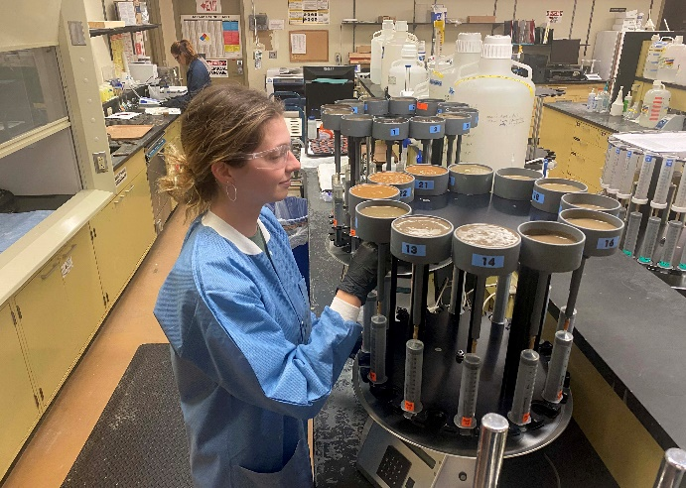

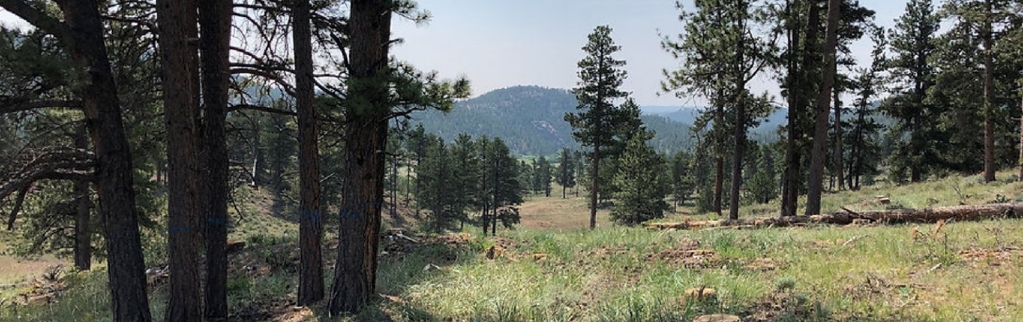
Module 6: Forest Ecosystem Management and Restoration with Soil Health Implications
Notes:
Introduction, support the ideas of the previous four modules in the spirit of continuous learning, continuous synthesis, and ultimately the idea of “go slow to go fast” leads to better conservation outcomes and benefits. Emphasize the importance of partnerships and the relationship that every part of the NRCS in all of our administrative divisions, supports authentic conservation strategies

Slide 2
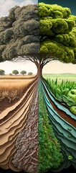
The Purpose
What we will learn with this module:
  Biodiversity and soil health are interrelated.
  Ecosystem resilience and biodiversity are related.
  What silvicultural practices can be used that could solve multiple resource concerns?
Notes:
This module will touch upon yesterday’s in-depth conversation about the principles to soil health and resource concerns, to several (but not all) of the Conservation Practices that facilitate improving, maintaining, or enhancing factors associated with soil health. The goal is to engage the audience with their lived experiences, knowledge without context to a personal an important way to them, is just knowledge that can be easily discarded or worse, disregarded. Be kind, be provocative, be in the moment with them and the content we want to “uncover”.

Slide 3
Management vs Restoration
The interplay between above ground and belowground structure and function holds great relevance to the maintenance of native biodiversity.
(Wardle 2002)
We cannot manage an ecosystem that needs restoration.
We cannot restore an ecosystem and not manage it.
In many cases, the best management might be restoration.
Notes:
Benign neglect is the outcome if we restore and do not manage….WRP example. Human intervention is required to manage a system that humans altered in the first place.

Slide 4
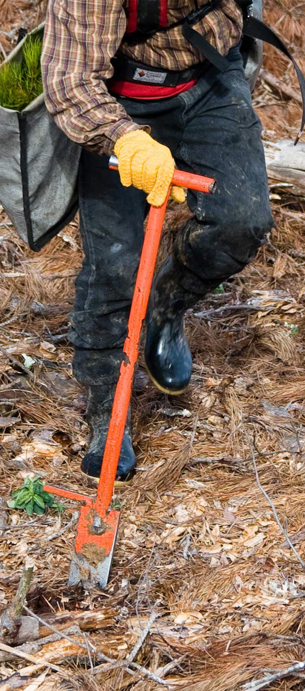
Restoration’s Past
Successful establishment of a target plant community = successful restoration.
Soil biota was not considered part of the restoration formula (Callaham et al 2008).
Monitoring and evaluation of function were not always considered.
Notes:
Often, we have considered tree planting as sufficient to restore a missing plant community or tree species without giving any consideration to soil concerns.

Slide 5
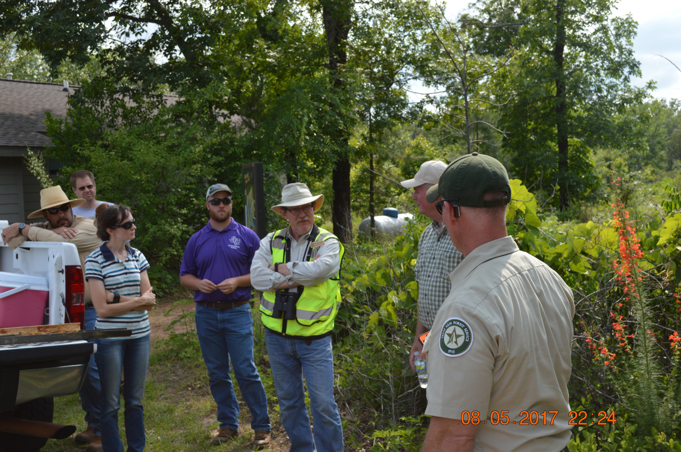
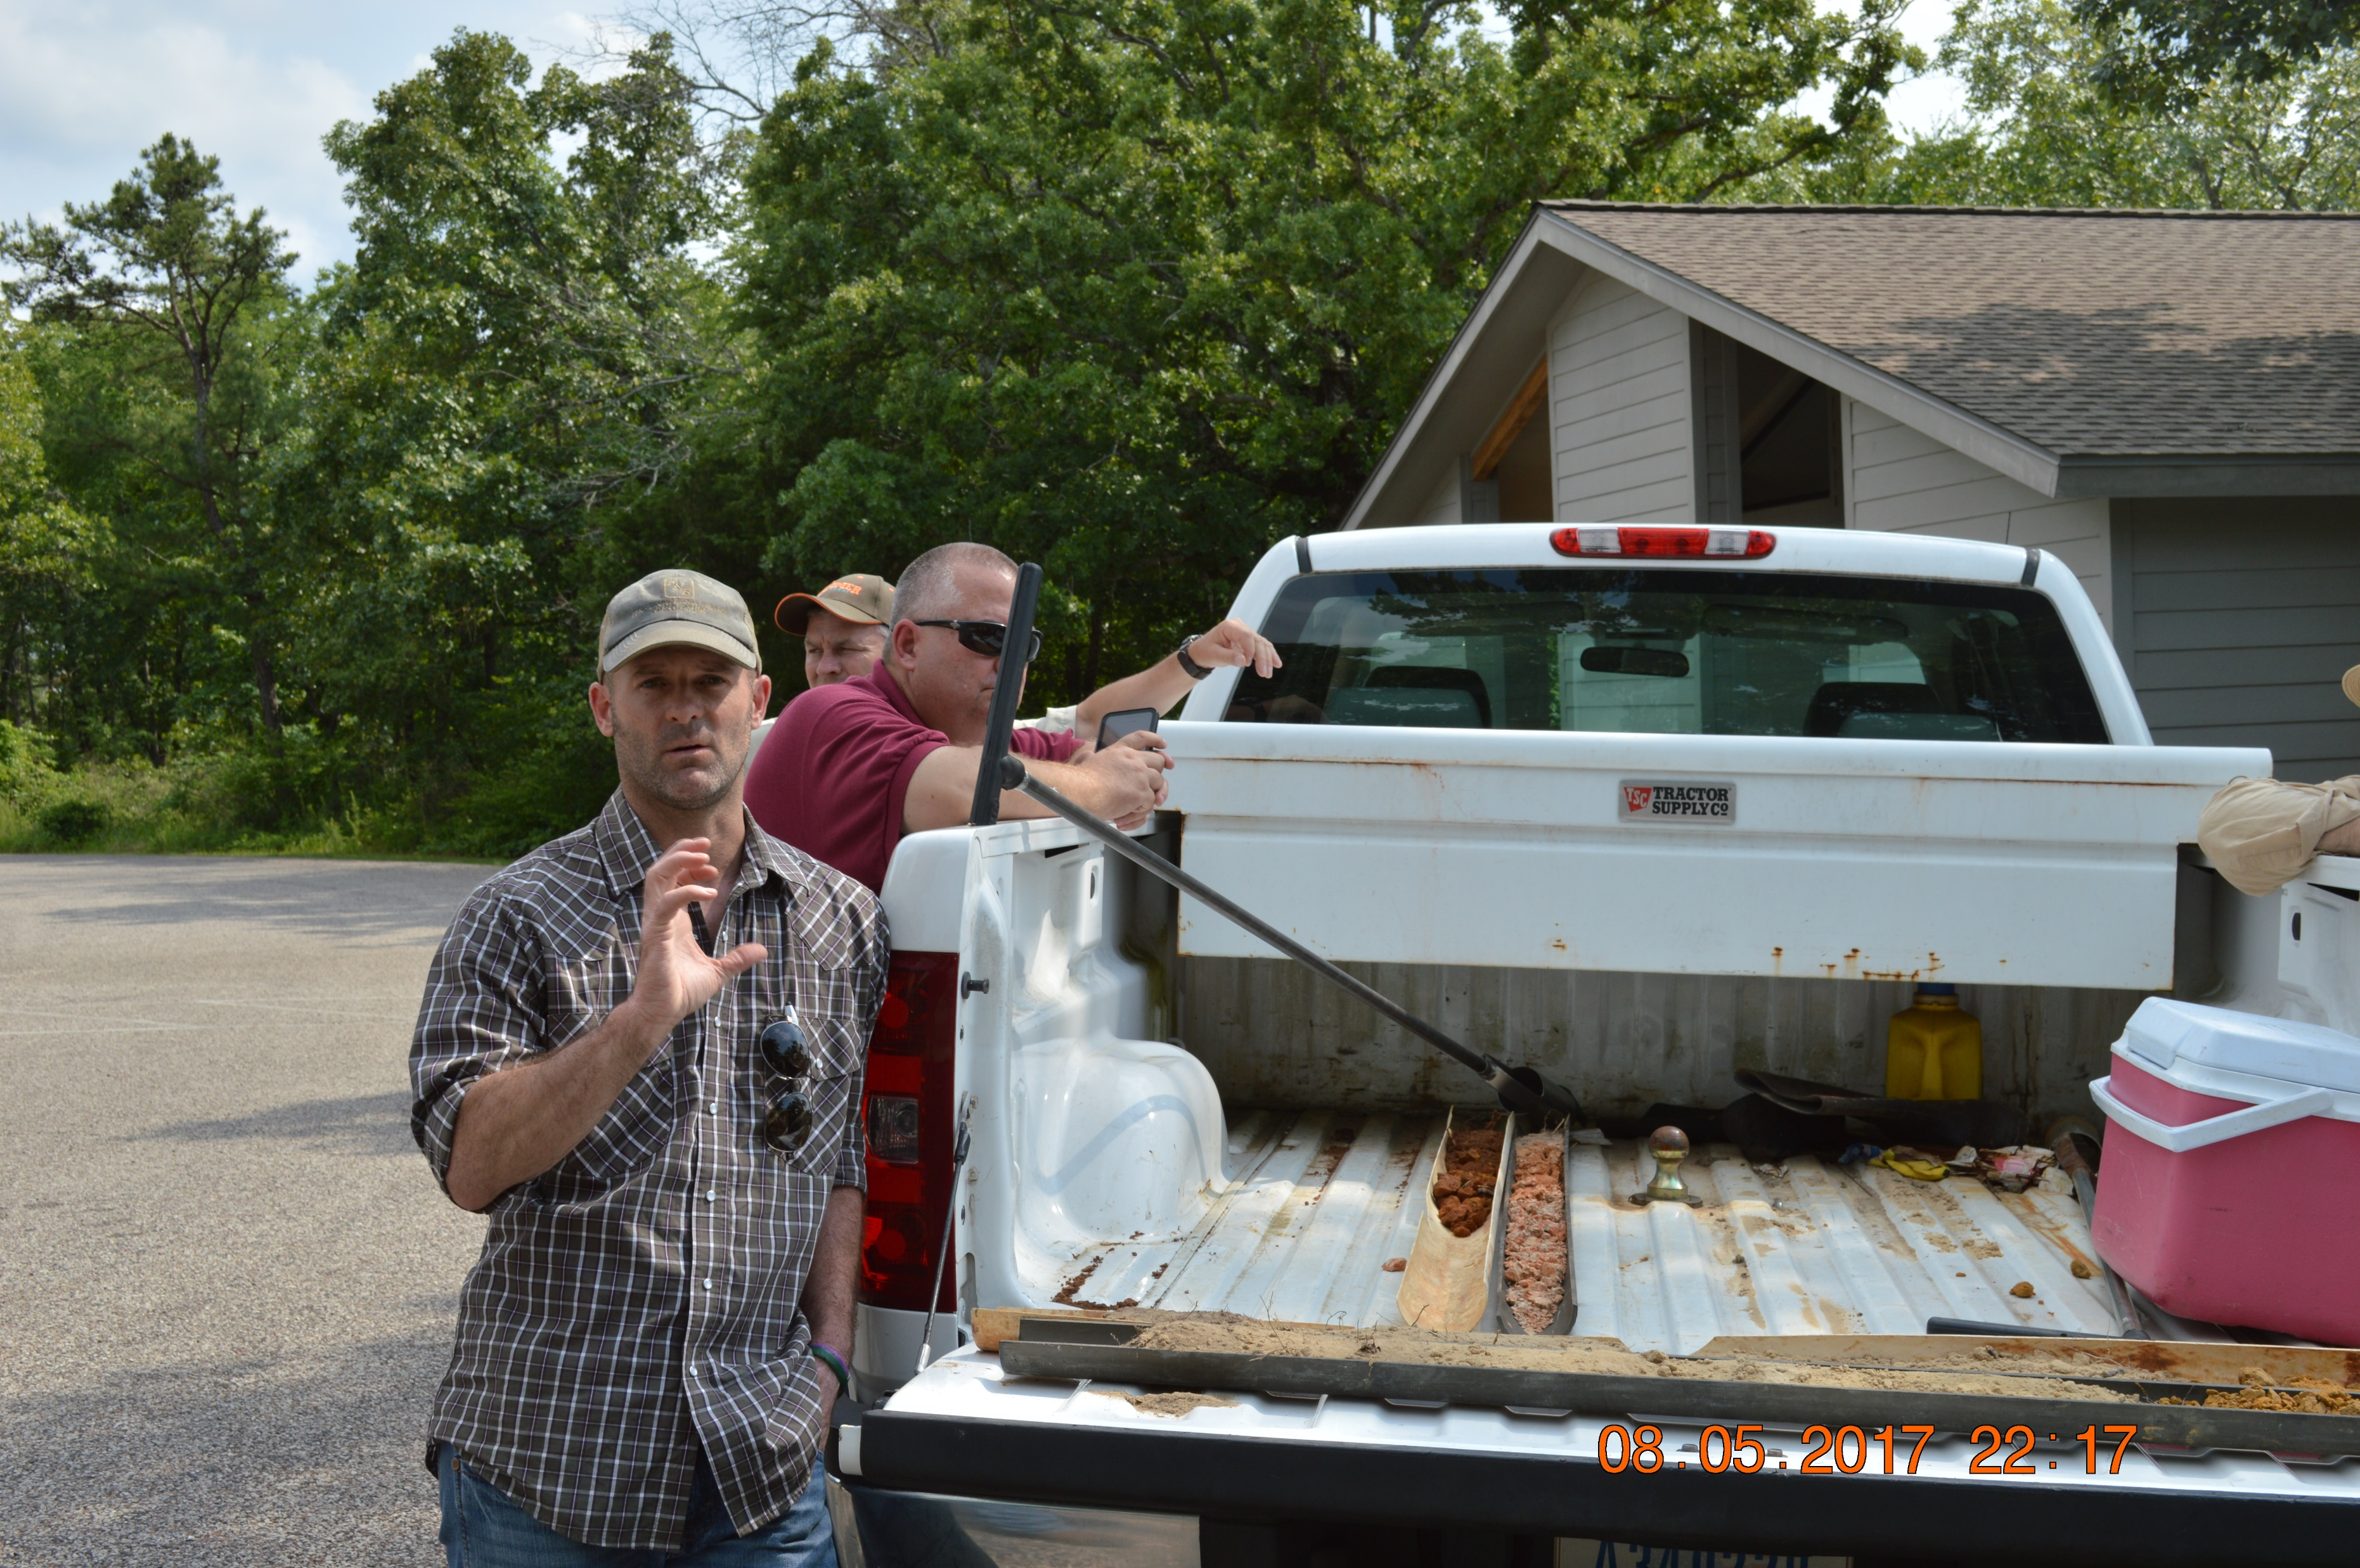
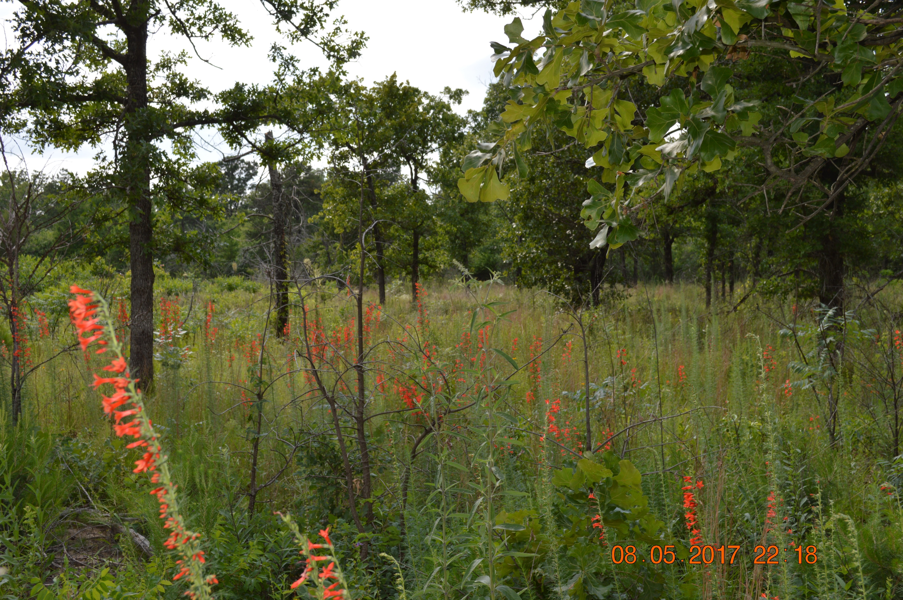
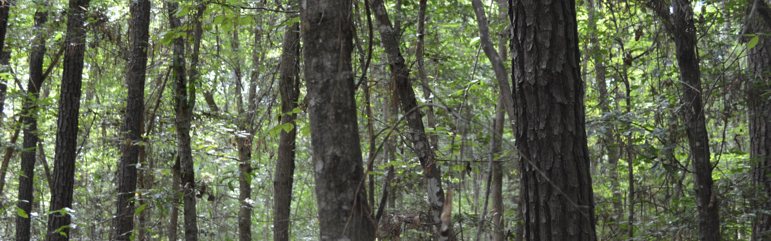
Soil knowledge is the foundation of our agency.
Notes:
Left to top right (1-3), Tyson Hart and Sara Russel NRCS soils and ESD specialists explaining soil-veg correlation with Dr. Jim Guldin on 2017 shortleaf pine tour at Tyler State Park. We were illustrating the soil connection between a shortleaf site and a blackjack oak site a few yards apart. Bottom right, coastal flatwoods in ETX during ESD mapping trip. Vastly different soils and veg.

Slide 6
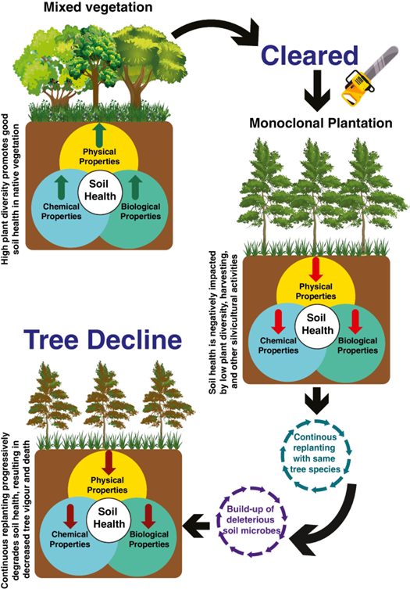
Biodiversity and soil health
Notes:
The world has 4-billion hectares of forest cover; 291 million Ha are in planted forests many of which are not in native environments. The soil microbiome is being altered by these planted forests and short rotations. From Bose et al 2023.

Slide 7
Biodiversity and soil health
Soil health is fostered by the synergistic effect of the physical, chemical and biological properties of the soil. High plant diversity in native vegetation promotes good soil health. Activities (Bose et al 2023).
A functioning ecosystem includes all the parts not just some of them.

Slide 8




What is Restoration?
Any improvement of conditions?
Promoting communities with (more) native species?
Making Nature whole again?
Utopian Care
There is a spectrum …
Intensive Care
Pragmatic Care
Triage Care
Benign Neglect
Malicious Neglect
Benign Neglect ≠ Utopian Care
Intentional Destruction

Slide 9

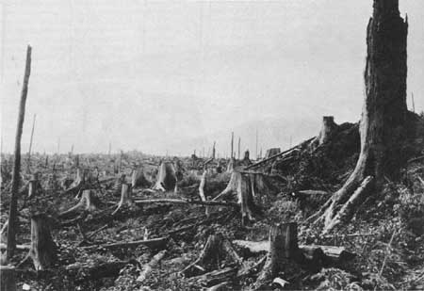
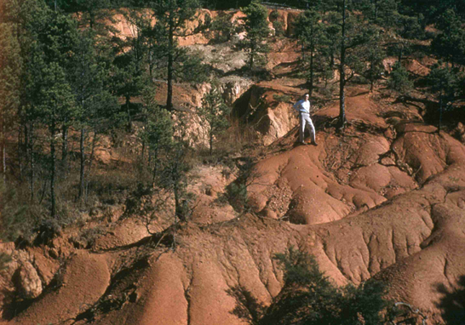
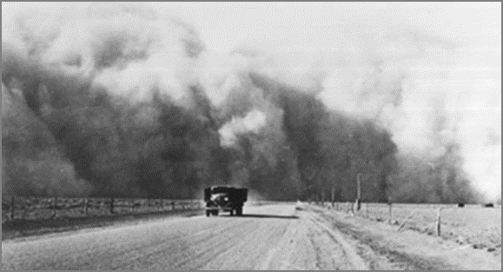
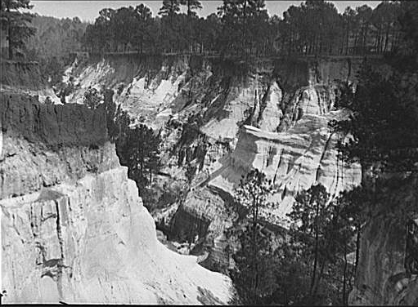
What’s Soil Got to Do With It?
From the beginning soil has played a central role in the
conservation ( = restoration?) movement in North America.
1899 – National Cooperative Soil Survey formed.
1910s – Soil Surveys in the South document erosion.
1933 – Soil Erosion Service is formed.
1935 – Passage of the Soil Conservation Act.
Notes:
We cannot forget the origins of our agency and the importance of soil. Soil health is just a continuation of our agency’s evolution.

Slide 10
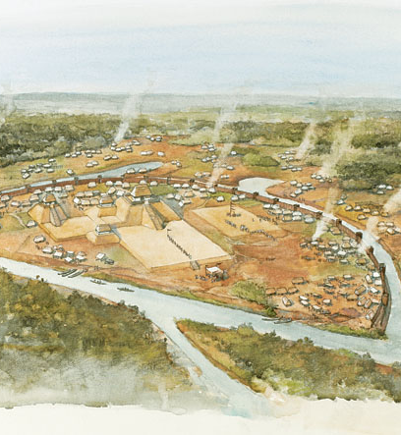
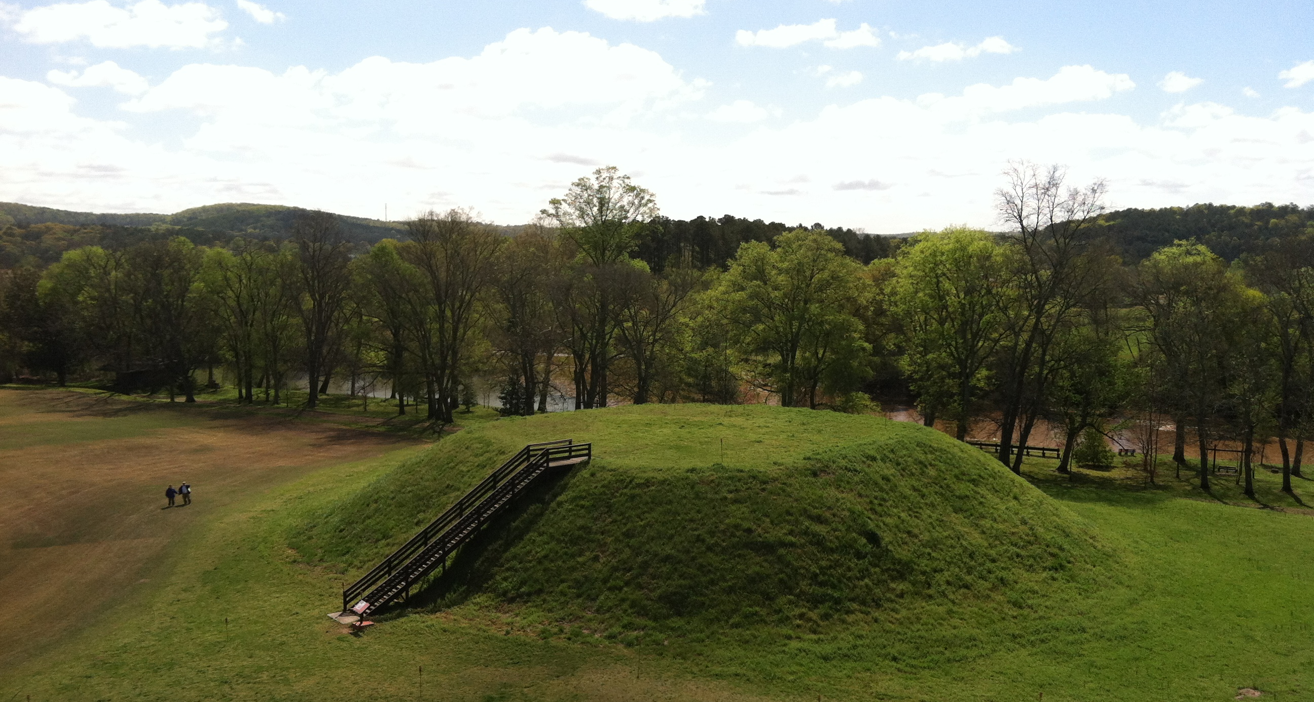
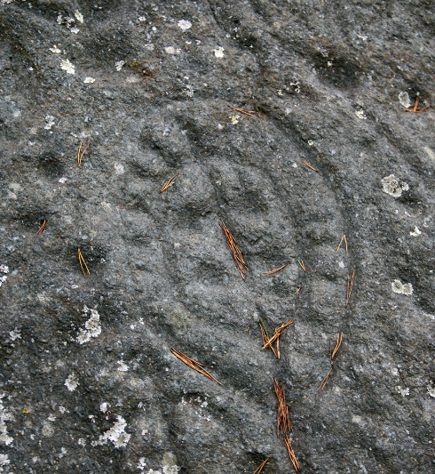
People have been managing the land for Millennia …
Notes:
We cannot leave humans out of the restoration-management conversation.

Slide 11
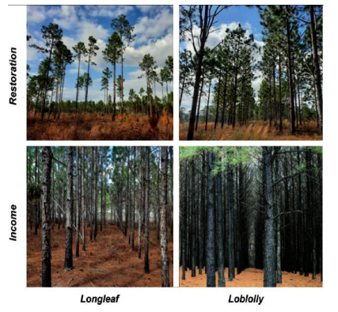
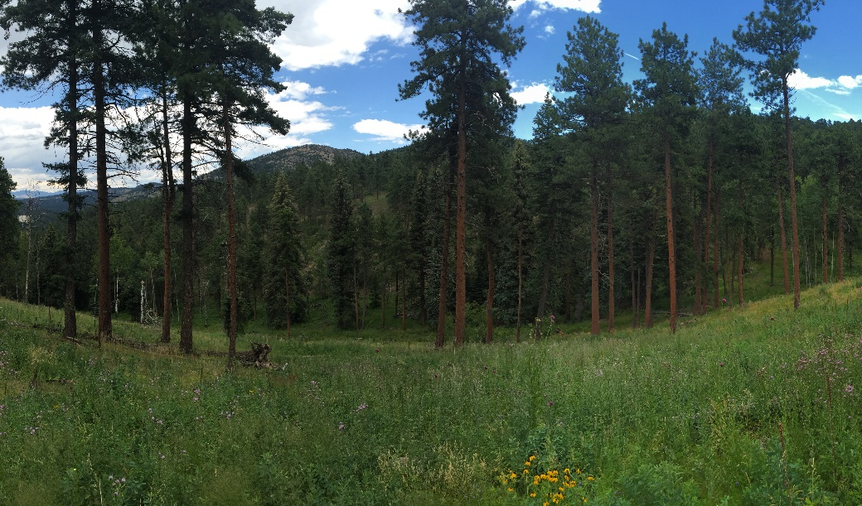
Purposes to Practices
“…forest biodiversity is driven by environmental variables that are under the direct control of the actual silvicultural management. Thus, forest management has an important responsibility and, at the same time, a huge opportunity to preserve (or even improve) the biodiversity of forests”.
Tinya et al. 2021
Which forestry practices address the soil health resource concerns with potential to maximize biodiversity?
  Forest Stand Improvement (666), Herbaceous Weed Treatment (315), Prescribed Burning (338), Restoration of Rare and Declining Natural Habitats (643), Tree/Shrub Establishment (612), others?
Feinstein 2014
Chambers et al 2024
Notes:
Biodiversity, what more can you say. Get the ecology right. Use ESDs or develop them according to NRCS policy. Understand the importance of resource allocation amongst plant functional traits and groups.
Citations:
Left photo: Jonas Feinstein, personal photo of West Ranch – Phase 1
Middle photo: Chambers J. English, Seth E. Younger, Jeffery B. Cannon, Steven T. Brantley, Daniel Markewitz, Puneet Dwivedi, Forest management for water yield: Assessing the barriers and impacts of privately-owned open pine woodlands in the Southeastern United States, Trees, Forests and People, Volume 17, 2024, 100600
Quotation on right panel: Flóra Tinya, Bence Kovács, András Bidló, Bálint Dima, Ildikó Király, Gergely Kutszegi, Ferenc Lakatos, Zsuzsa Mag, Sára Márialigeti, Juri Nascimbene, Ferenc Samu, Irén Siller, Győző Szél, Péter Ódor,
Environmental drivers of forest biodiversity in temperate mixed forests – A multi-taxon approach, Science of The Total Environment, Volume 795, 2021,

Slide 12


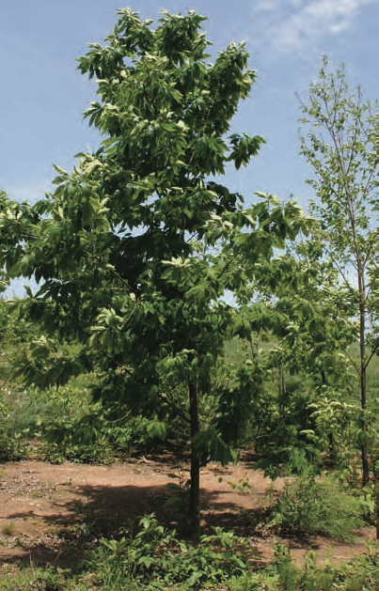
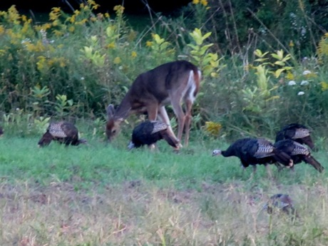
Be Optimistic!
Interventions for Soil Health can be wildly successful!

Slide 13
Thank you!
For more information on Managing Soil Health,
visit us here:
https://www.nrcs.usda.gov/conservation-basics/natural-resource-concerns/soils/soil-health
USDA is an equal opportunity provider, employer, and lender.

